Slide 1
Hobby Store Online Platform
Group 02
For: The Sword & Board Toronto

Slide 2

Team Members
Nolan Honey Lead / UI / Back-End
Harry Archer UI
Saif Mustaf Back-End
Jan Farun Database / Back-End
Notes:
JAN FARUN

Slide 3
Little bit about our group...
Have worked together since first semester
We help each other
We learn from each other
We have fun working on our projects
Notes:
JAN FARUN

Slide 4

Project Description
This project is created in collaboration with a local Toronto business: “The Sword & Board” to create an effective website to manage card inventory, pricing and availability.
Notes:
JAN FARUN

Slide 5
Business Introduction
The Sword & Board has been in business for just over a year now serving customers from all edges of the gaming world.
They are collectors and enthusiasts of board games, RPG’s, CCG’s and miniature games.
One of their most actively selling games is the Magic: The Gathering (MTG) trading card game.
Released in 1993 the massive following estimated to be about 20 million players in 2015.
Notes:
JAN FARUN

Slide 6
Business Opportunity
Transactions have been purely physical thus far and the store does not currently have a way for customers or staff to go online to check card inventory, prices, previous transaction history or store credit balance.
The Online Marketing Platform that our team is proposing will solve this problem and create an effective tool that the store can use to showcase their MTG card collection and track the day-to-day transactions of players.
Notes:
JAN FARUN

Slide 7
Problem
Store does not have an MTG(Magic The Gathering) card online marketing platform
Insufficient system set up to keep track of customer orders / store credit
No database exists that tracks current stock of MTG cards
Notes:
HARRY ARCHER

Slide 8
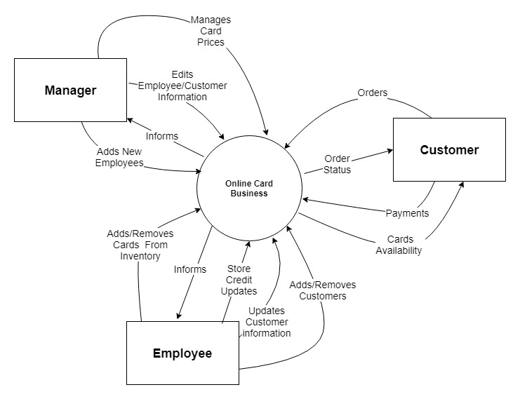
High Level Requirements
Requirement Scope Area
Online Card Business
External Entity
Manager
Employee
Customer
Information Flows
Adds new employee
Edits employee/customer information
Manages card prices
Informs
Orders
Order Status
Card availability
Payments
Add/removes cards from inventory
Store credit updates
Updates customer information
Adds/removes customers
Notes:
HARRY ARCHER

Slide 9

SOLUTION
Create an effective online marketing platform that enables versatile solutions depending on client needs
Create database that tracks customer store credit and transaction history. It can be viewed by customers and edited by employees
Create database that tracks inventory of MTG cards
Notes:
NOLAN HONEY

Slide 10
Project Plan: Corporate Goals
The goals to be accomplished by this project include:
An increase in profit through an increase in advertised products and increased exposure.
An increase in exposure through a properly and well designed corporate website.
An increase in employee efficiency through an improved store credit system and a streamlined pricing method.
Notes:
NOLAN HONEY

Slide 11
Project Plan: Assumptions and Dependencies
Assumptions
The stakeholder will not be implementing all of the developed software. Since the software will be developed modularly, this should not be an issue.
Dependencies
The software being produced depend on two third party sources. The source of all cards come from the card manufacturers own database. Card prices also come from 3rd party retailers and price indexes.
Notes:
NOLAN HONEY

Slide 12
Team Charter
Purpose:
This team was formed to complete the capstone project. We expect to create a usable software system for many small businesses in the hobby gaming world that wish to have an online business presence. The software will provide core business functions such as a store credit system, a way to track inventory, and a way to track product prices.
Team composition:
Our team comprises of people who specialize in all needed areas of programming and software design. From UI to databases, each one of us has our own preference of role. Each member typically has one main role and one supplementary role where they will help out when able. UI and front-end design has two members, back-end/server side development has three developers and there is one dedicated database designer. We expect a lot of time will be committed to the back end design as that is the most extensive area of need.
Notes:
SAIF MUSTAF

Slide 13
Team Charter Continued
Team empowerment:
The authority of the team is nearly entirely flat. The official team leader is Nolan Honey, simply due to his involvement in the projects real-world application. Everyone is on equal footing when deciding project features and which directions it should go. Work is divided fairly and evenly where every group members gets to choose what part they want to do. Group members are fully empowered.
Team operations
The team makes decisions as a democratic group. If a change in membership was to occur, it would also be done democratically. The only rules are to complete work on time and communicate with the group. The team leader organises group meetings with the business partners and acts as the communication link between the team and the business partners.
Notes:
SAIF MUSTAF

Slide 15
Sprint Backlog
Sprint 1:
Create a Database
Allow manager to take system offline for any reason
Create UI to interact with Database
Create form to add need employees to a system
Create page that displays list of employees
Sprint 2:
Create a form to add new cards to database
Create a form to add new customer to stores database
Create web page to display store cards inventory
Create web page to display list of store registered customers
Create page to add refund to customer store credit or to his Paypal account
Display web page to customer and allow him to modify basic customer informations
Sprint 3:
On login allow customers to reset their password
Create web page to allow customers to add cards to shopping cart
Get competitors card prices so customer knows they are getting the best deal
Display store credit to Customer in his profile page
On stores Homepage display upcoming events so customers can prepare for upcoming games
Notes:
SAIF MUSTAF

